Slide 1
I/O Principles
October XX, 20XX
Fundamentals and Device Interfaces

Slide 2
Introduction
This presentation covers the fundamental principles of Input/Output (I/O) systems. It highlights how data exchange between computers and peripheral devices occurs, emphasizing the roles of device controllers and types of I/O devices for effective system communication.

Slide 3

01
Principles of I/O

Slide 4
Definition and importance of I/O
Input/Output (I/O) refers to the communication process between a computer system and external devices. It is essential for enabling user interaction, data storage, and retrieval. Proper I/O management ensures efficient and reliable exchange of information for seamless computer operation.

Slide 5
I/O operations overview
I/O operations involve transferring data between the CPU, memory, and peripheral devices. These include input (data reading) and output (data writing) tasks. Efficient handling of these operations is critical to optimizing system performance and minimizing delays.

Slide 6

Types of I/O devices
I/O devices are classified as input devices (e.g., keyboard, scanner), output devices (e.g., monitor, printer), and storage devices (e.g., hard disks, SSDs). Each type plays a specific role in data communication and system interaction.

Slide 7

02
Device Controller

Slide 8
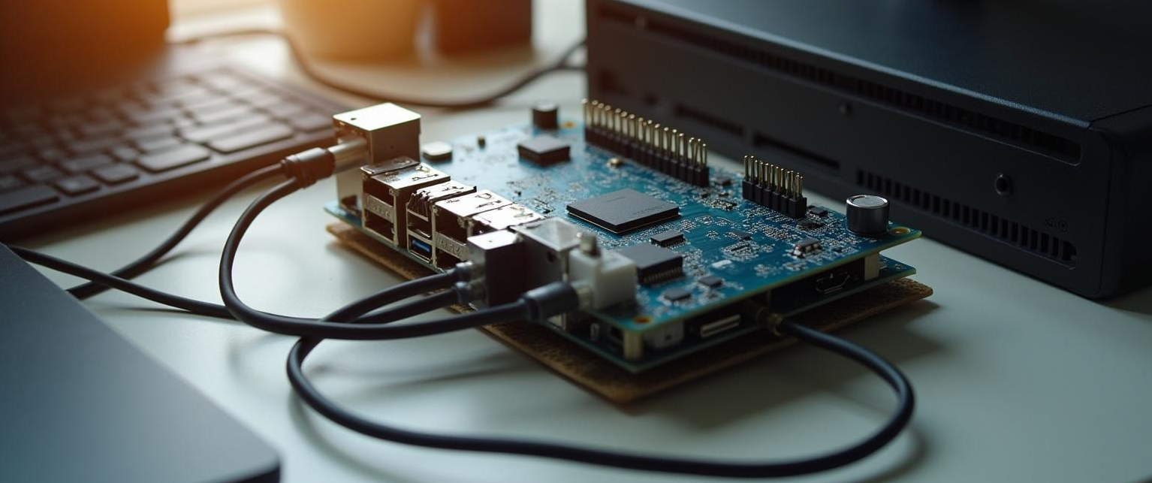
Role of device controllers
Device controllers act as intermediaries between the CPU and I/O devices. They manage data flow, device commands, and status signals, allowing devices to operate independently and enhancing overall system efficiency.

Slide 9
Interaction with CPU and memory
Device controllers communicate with the CPU through interrupts and control signals. They coordinate data transfer via system buses and typically use internal buffers to streamline data flow, reducing CPU workload during I/O operations.

Slide 10
Examples of device controllers
Examples of device controllers include disk controllers, which manage data storage devices, keyboard controllers that handle input from keyboards, and network interface controllers managing network communications. These controllers serve as vital intermediaries between the CPU and hardware, facilitating efficient and reliable device operation.

Slide 11
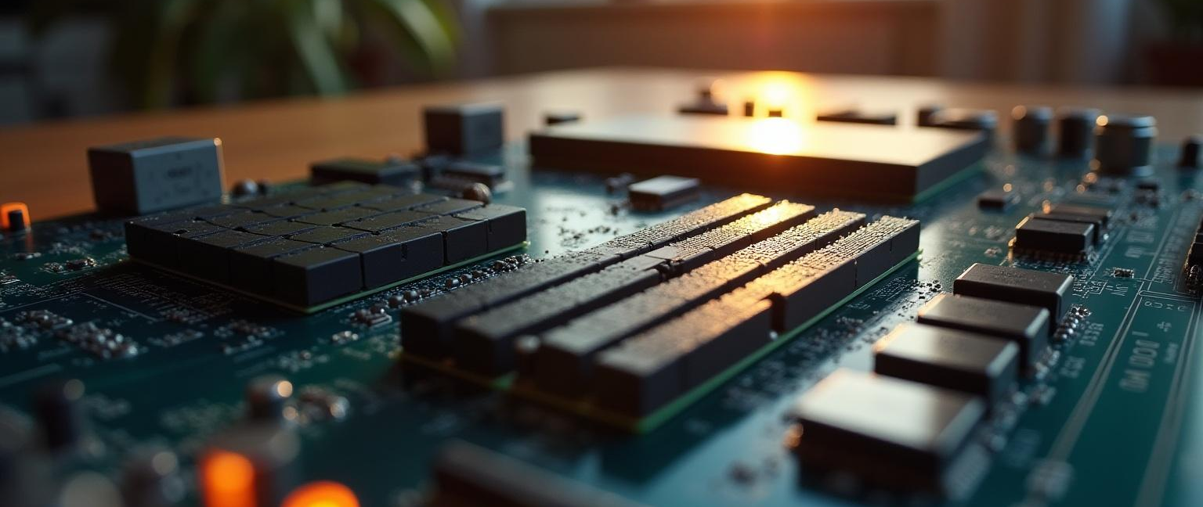
03
Memory Swapped I/O and DMA

Slide 12
Memory swapped I/O mechanism
Memory swapped I/O maps device registers directly into the systems memory address space. This enables the CPU to access device registers using standard memory instructions, facilitating simpler and faster communication without specialized I/O instructions.

Slide 13
Direct Memory Access (DMA) concept
DMA allows peripherals to transfer data directly to or from memory without continuous CPU intervention. A dedicated DMA controller handles these transfers independently, reducing CPU overhead and improving data transfer efficiency in high-speed operations.

Slide 14

Advantages of DMA in data transfer
DMA reduces CPU workload by offloading data transfer tasks, enabling concurrent CPU processing and data movement. This leads to faster throughput, lower latency, and overall enhanced system performance, especially in data-intensive applications.

Slide 15

04
I/O Software and Programmed I/O

Slide 16

I/O software goals and functions
I/O software aims to abstract hardware complexity, provide device independence, manage data transfers efficiently, and handle errors. It facilitates smooth interaction between applications and hardware, enhancing usability and reliability in system operations.

Slide 17
Principles of I/O software design
Effective I/O software design emphasizes modularity, hardware abstraction, and layering. It separates device-specific control from higher-level logic, ensuring robustness, easy maintenance, and scalable integration with new hardware.

Slide 18
Programmed I/O method explained
Programmed I/O requires the CPU to actively control data transfers by polling device status registers. While straightforward, it consumes significant CPU time and is less efficient compared to interrupt-driven or DMA methods, especially during large or frequent data exchanges.

Slide 19
Conclusions
Understanding the principles of I/O, device controllers, and advanced data transfer techniques like DMA is crucial for optimizing system performance. Well-designed I/O software ensures effective communication between hardware and software, enhancing reliability, efficiency, and scalability in computing environments.

Slide 20
Thanks for your attention
Do you have any questions?
Www.noquestion.com | +977 980 000 000 0000 | noquestion@gmail.com

